Slide 1
Computer Organization & Design 实验与课程设计
Computer Organization & Design
lab6
CPU design-controller

Slide 2
Course Outline
Environment
Task
Principles
Implementation
Notes:
Rudimentary logic functions=基本的逻辑函数

Slide 3
Goal
1. Register transfer control usage
2. Master the key of CPU：instruction execution and data flow
3. Design controller
4. Learn test case design
5. Learn test program design

Slide 4
Environment
Setup
1. Computer（Intel Core i5，4GB memory）
2. Spartan-3 Starter Kit Board/Sword
3. Xilinx ISE14.4

Slide 5
Course Outline
Environment
Task
Principles
Implementation
Notes:
Rudimentary logic functions=基本的逻辑函数

Slide 6
Task
1. Design controller to support 9⁺ instructions
Implement controller using HDL
Complete truth table for control signal based on datapath of Exp05 and instruction encoding
Substitute the controller core of Exp05
Finish this lab based on Exp05
2. Design test for controller：
OP decoding test：R-format、lw/sw、branches，jump
Operation control test：Function decoding test

Slide 7
Course Outline
Environment
Task
Principles
Implementation
Notes:
Rudimentary logic functions=基本的逻辑函数

Slide 8
CPU organization
Digital circuit
General circuits that controls logical event with logical gates --Hardware
Computer organization
Special circuits that processes logical action with instructions -Software
Data input
Control unit
Control signals
Datapath
Data output
Status input
Status signals
Control output

Slide 9
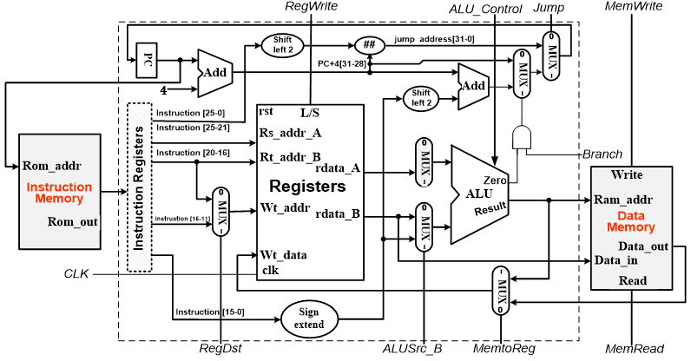
Control object：data path
Write down the truth table for the control signals
ALU Control
controller
ALU OP
MemRead
Instroction[5:0]
MemWrite
Instruction[31:26]
Branch
Jump
MemtoReg
ALUScr_B
RegWrite
RegDst

Slide 10
Control signals
信号 | 源数目 | 功能定义 | 赋值0时动作 | 赋值1时动作
ALUSrc_B | 2 | Choice for B port of ALU | choose register B | Choose 32-bits immediate（after extension）
RegDst | 2 | Choice for write address for register | Choose rt | Choose rs
MemtoReg | 2 | Choice for register write-data | Choose data for memory | Choose ALU output
Branch | 2 | Choose beq target address | PC+4 | Branch address（Zero=1）
Jump | 2 | Choose jump target address | J target address | Output is decided by Branch
RegWrite | - | Register write control | Register write disabled | Register write enabled
MemWrite | - | Memory write control | memory write disabled | memory write enabled
MemRead | - | Memory read control | memory read disabled | memory read enabled
ALU_Control | 000- 111 | 3-bits ALU control | Refer to Lab4 | Lab4

Slide 11
Truth table of main controller
Analyze and complete the following truth table
OP | Reg Dst | ALU Src | Mem toReg | Reg Write | Mem Read | Mem Write | Branch | Jump | ALU _{op1} | ALU _{op0}
R-格式 000000
I-格式LW ???
I-格式SW ???
I-格式beq ???
J-格式 ???

Slide 12
ALU operation decoder Second level
参考实验四
Instruction opcode | ALUop | Instruction operation | Funct field | Desired ALU action | ALU_Control
LW | 00 | Load word | xxxxxx | Load word | 010
SW | 00 | Store word | xxxxxx | Store word | 010
Beq | 01 | branch equal | xxxxxx | branch equal | 110
R-type | 10 | add | 10 0000 | add | 010
R-type | 10 | subtract | 10 0010 | subtract | 110
R-type | 10 | AND | 10 0100 | AND | 000
R-type | 10 | OR | 10 0101 | OR | 001
R-type | 10 | Set on less than | 10 1010 | Set on less than | 111
R-type | 10 | NOR | 100111 | NOR | 100

Slide 13
ALU OP optimization
Optimization for Funct variables
ALUop will be considered separately
optimization
???
F₁F₀
F₃F₂
F₁F₀
F₃F₂
?
?
F₁F₀
F₃F₂
0 | x | x | 1
0 | 0 | 1 | x
x | x | x | x
x | x | x | 1
?
1 | x | x | 1
0 | 0 | 0 | X
x | x | x | X
1 | x | x | 1
0 | x | x | 0
0 | 1 | 0 | X
x | x | x | X
x | x | x | 1
?
反函数简单

Slide 14
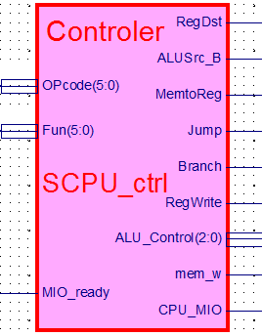
CPU part：SCPU_ctrl
SCPU_ctrl
Main part of CPU
To control register transfer：code convert to command
Function
microcontrol
Datapath control
Timing control：where is timing for simple implementation of CPU？
interface- SCPU_ctrl
Interface signals are as in right figure
Symbol file：SCPU_ctrl.sym

Slide 15
SCPU_ctrl.v
module SCPU_ctrl( input[5:0]OPcode, //OPcode
input[5:0]Fun, //Function input MIO_ready, //CPU Wait
output reg RegDst,
output reg ALUSrc_B,
output reg MemtoReg,
output reg Jump,
output reg Branch,
output reg RegWrite,
output reg mem_w,
output reg [2:0]ALU_Control,
output reg CPU_MIO
);
endmodule

Slide 16
Course Outline
Environment
Task
Principles
Implementation
Notes:
Rudimentary logic functions=基本的逻辑函数

Slide 17
CPU controller design
-to control the datapath in Exp05

Slide 18
Project：OExp06-OwnSCPU
Design CPU controller
Design controller to control datapath of Exp05
Use either schematic or HDL description
Must use function expression structure description
simulation
Substitute core using your own datapath module
To replace SCPU_ctrl.ngc core in Exp05
Top is same as Exp05
rename：Top_OExp06_OwnSCPU.sch
Controller test
Design MIPS assembler code to test:
OP decoding test：
R-format、memory-reference、branch、jump instructions
Operation control：Function decoding test

Slide 19
设计要点
Design main controller
Write down the function expression
Implement using structure description
Design ALU decoder
Write down the function expression for ALU decoder
Implement using structure description
Use DEMO for initial debug
ALU must include “nor”operation
Otherwise modification is required
Simulation for the above two modules
Simulation can be separate or be combined together. Two modules must be combined into one module at end.

Slide 20
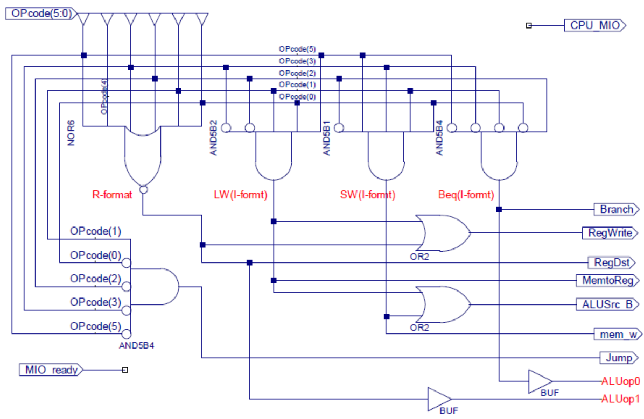
Instruction decoder-main controller

Slide 21
HDL description for controller
`define CPU_ctrl_signals {RegDst,ALUSrc_B,MemtoReg,RegWrite,MemRead,MemWrite,Branch,Jump,ALUop}
assign mem_w = MemWrite&&(~MemRead);
always @* begin
case(OPcode)
6‘b000000: begin CPU_ctrl_signals = ?; end //ALU
6'b100011: begin CPU_ctrl_signals = ?; end //load
6'b101011: begin CPU_ctrl_signals = ?; end //store
6'b000100: begin CPU_ctrl_signals = ?; end //beq
6'b000010: begin CPU_ctrl_signals = ?; end //jump
6'h24: begin CPU_ctrl_signals = ?; end //slti，增加ALUop编码
……
default: begin CPU_ctrl_signals = ?; end
endcase
end

Slide 22
Controller simulation
initial begin
// Initialize Inputs
OPcode = 0;
Fun = 0;
MIO_ready = 0;
#40;
// Wait 40 ns for global reset to finish。以上是测试模板代码。
// Add stimulus here
//检查输出信号和关键信号输出是否满足真值表
OPcode = 0; //ALU指令，检查 ALUop=2'b10; RegDst=1; RegWrite=1
Fun = 6'b100000; //add,检查ALU_Control=3'b010
#20;
Fun = 6'b100010; //sub,检查ALU_Control=3'b110
#20;
Fun = 6'b100100; //and,检查ALU_Control=3'b000
#20;
Fun = 6'b100101; //or,检查ALU_Control=3'b001
#20;
Fun = 6'b101010; //slt,检查ALU_Control=3'b111
#20;
Fun = 6'b100111; //nor,检查ALU_Control=3'b100
#20;

Slide 23
Controller simulation
#20;
Fun = 6'b000010; //srl,检查ALU_Control=3'b101
#20;
Fun = 6'b010110; //xor,检查ALU_Control=3'b011
#20;
Fun = 6'b111111; //间隔
#1;
OPcode = 6'b100011;//load指令，检查 ALUop=2'b00, RegDst=0,
#20; // ALUSrc_B=1, MemtoReg=1, RegWrite=1
OPcode = 6'b101011;
#20; //store指令，检查ALUop=2'b00, mem_w=1, ALUSrc_B=1
OPcode = 6'b000100;//beq指令，检查 ALUop=2'b01, Branch=1
#20;
OPcode = 6'b000010; //jump指令，检查 Jump=1
#20;
OPcode = 6'h24; //slti指令，检查ALUop=2'b11, RegDst=0,
#20; //ALUSrc_B=1, RegWrite=1
OPcode = 6'h3f; //间隔
Fun = 6'b000000; //间隔
end

Slide 24
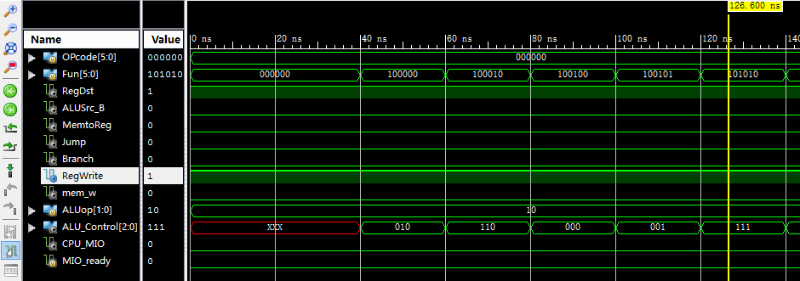
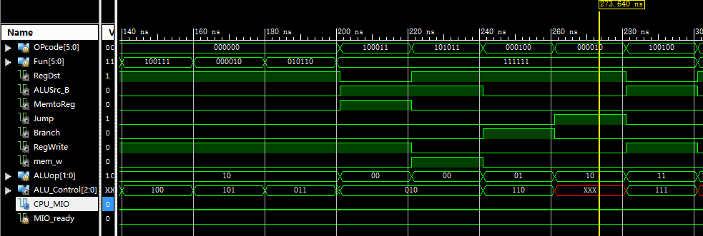
Controller simulation result

Slide 25
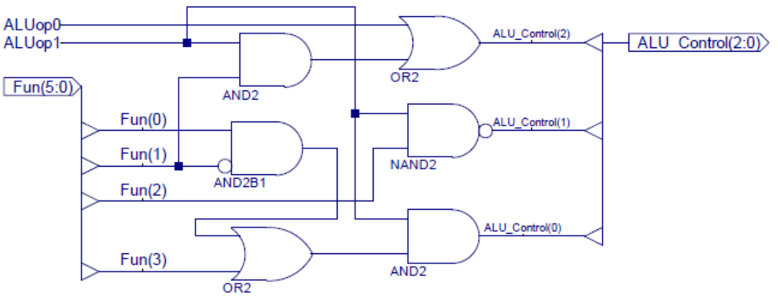
ALU op decoder

Slide 26
HDL description for ALU op
ALU控制器参考描述
always @* begin
case(ALUop)
2'b00: ALU_Control = ? ; //add计算地址
2'b01: ALU_Control = ? ; //sub比较条件
2'b10:
case(Fun)
6'b100000: ALU_Control = 3'b010 ; //add
6'b100010: ALU_Control = ? ; //sub
6'b100100: ALU_Control = ? ; //and
6'b100101: ALU_Control = ? ; //or
6'b101010: ALU_Control = ? ; //slt
6'b100111: ALU_Control = ? ; //nor:~(A | B)
6'b000010: ALU_Control = ? ; //srl
6'b010110: ALU_Control = ? ; //xor
……
default: ALU_Control=3'bx;
endcase
2'b11: ALU_Control = ? ; //slti
endcase

Slide 27
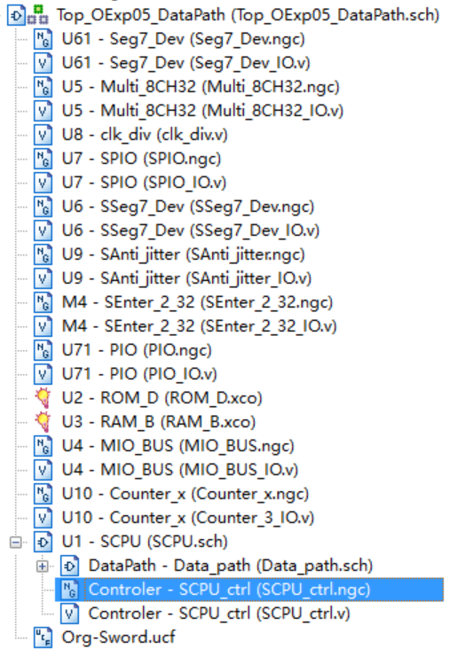
Controller substitution
substitution
Substitute IP core of Exp05 after correct simulation
Remove core from project
Remove core associated files from project
Remove core file from project
SCPU_ctrl.ngc
In the Project menu, run： Cleanup Project Files …
Suggest to rebuild project
Exclude SCPU_ctrl.ngc
Exp05 core files to be removed

Slide 28
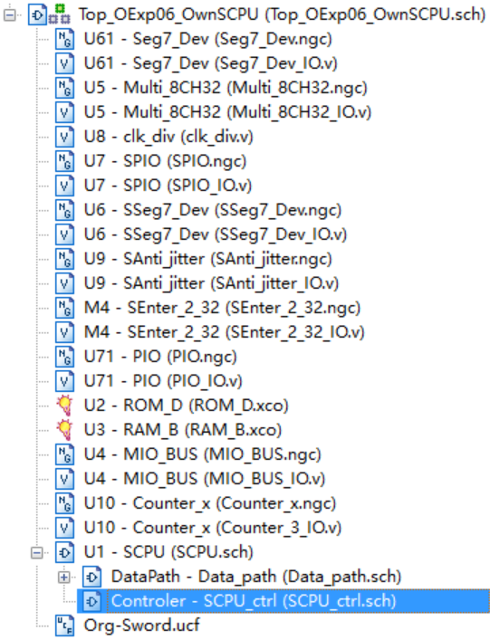
Module Structure after substitute SCPU_ctrl core
Exp06 module calling relation after datapath substitution
Controller after substitution

Slide 29
Physical verification
Use DEMO program to observe the function of controller( same as Exp05)
DEMO interface
SW[7:5]=000， SW[2]=0(全速运行)
SW[4:3]=00， SW[0]=0，点阵显示程序：跑马灯
SW[4:3]=00， SW[0]=0，点阵显示程序：矩形变幻
SW[4:3]=01， SW[0]=1，内存数据显示程序：0～F
SW[4:3]=10， SW[0]=1，当前寄存器R9+1显示
Use assembler language to design test program
Test ALU instruction(R-format decoding、 Function decoding)
Test LW/SW instruction (I-format decoding)
Test branch instruction (I-format decoding)
Test jump instruction (J-format decoding)

Slide 30
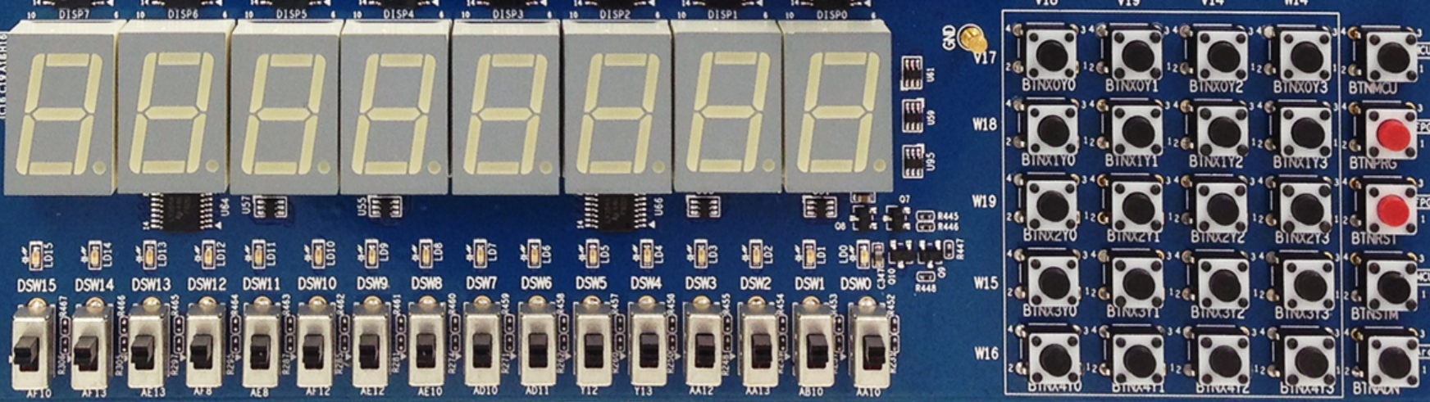
DEMO interface
X₀Y₀
X₀Y₁
X₀Y₂
X₀Y₃
MCU3
0
1
2
3
X₁Y₀
X₁Y₁
X₁Y₂
X₁Y₃
PRGO
SEG3
SEG2
SEG1
SEG0
SEG3
SEG2
SEG1
SEG0
4
5
6
7
X₂Y₀
X₂Y₁
X₂Y₂
X₂Y₃
RSTN
LED15 LED14 LED13 LED12 LED11 LED10 LED9 LED8 LED7 LED6 LED5 LED4 LED3 LED2 LED1 LED0
8
9
A
B
X₃Y₀
X₃Y₁
X₃Y₂
X₃Y₃
MCU1~2
C
D
E
F
W15 SW14 SW13 SW12 SW11 SW10 SW9 SW8 SW7 SW6 SW5 SW4 SW3 SW2 SW1 SW0
X₄Y₀
X₄Y₁
X₄Y₂
X₄Y₃
Ardunio
SW[7:5]=显示通道选择
SW[7:5]=000：CPU程序运行输出
SW[7:5]=001：测试PC字地址
SW[7:5]=010：测试指令字
SW[7:5]=011：测试计数器
SW[7:5]=100：测试RAM地址
SW[7:5]=101：测试CPU数据输出
SW[7:5]=110：测试CPU数据输入
SW[0]=文本图形选择
SW[1]=高低16位选择
没有使用
SW[2]=CPU单步时钟选择
DEMO功能，测试程序可以替换成自己的功能
SW[4:3]=00，点阵显示程序：跑马灯
SW[4:3]=00，点阵显示程序：矩形变幻
SW[4:3]=01，内存数据显示程序：0～F
SW[4:3]=10，当前寄存器+1显示

Slide 31
Test program：ALU instructions
Design ALU instruction test program to substitute DEMO program
ALU、Regs test，test result can be observed by CPU output
SW[7:5]=100, Addr_out = ALU output
SW[7:5]=101，Data_out= register B output
#baseAddr 0000
loop: nor r1,r0,r0; //r1=FFFFFFFF
slt r2,r0,r1; //r2=00000001
add r3,r2,r2; //r3=00000002
add r4,r3,r3; //r4=00000004
add r5,r4,r2; //r5=00000005
add r6,r5,r5; //r6=0000000A
nor r7,r5,r5; //r7=FFFFFFFA
sub r8,r7,r5; //r8=FFFFFFF5
and r9,r8,r5; //r9=00000005
and r10,r8,r6; //r10=00000000
or r11,r5,r6; //r11=0000000F
or r12,r11,r7; //r12=0000000A
slt r13,r5,r7; //r13=00000000
……
j loop;

Slide 32
Test LW/SW
Design LW/SW test program to substitute DEMO program
Refer to Lab5 datapath test,test results can be observed by CPU output
Memory address can be observed by Addr_out datapath 4：14+$zero
#baseAddr 0000
start: //通道结果由后一条指令读操作数观察
lw r5, 14($zero); //取测试常数55555555。存储器读通道
start_A:
add r1, r5, $zero; //r1: 寄存器写通道。R5:寄存器读通道A输出
nor r2, $zero, r1; //r1: 寄存器读通道B输出。R2:ALU输出通道
lw r5, 48($zero); //取测试常数AAAAAAAA。立即数通道:00000048
beq r2, r5 test_sw; //循环测试
j start; //循环测试。立即数通道：00000014
test_sw: …… //增加写SW测试，如14和48单元交换
j start; //循环测试。立即数通道：00000014
Test completeness
The above test can only demonstrate the correctness of address computing, memory transmission and bus transmission
For completeness test, must try every possible case

Slide 33
Dynamic LW/SW test
Use 7-seg display to design dynamic test program
The address of 7-seg display is E0000000/FFFFFFE0
LED display address: F0000000/FFFFFF00
The output of SW instruction test：sw
Design test program for memory
Test result is shown on 7-seg display
RAM initialization is the same as Lab5
F0000000, 000002AB, 80000000, 0000003F, 00000001, FFF70000, 0000FFFF, 80000000, 00000000, 11111111, 22222222, 33333333, 44444444, 55555555, 66666666, 77777777, 88888888, 99999999, aaaaaaaa, bbbbbbbb, cccccccc, dddddddd, eeeeeeee, FFFFFFFF, 557EF7E0, D7BDFBD9, D7DBFDB9, DFCFFCFB, DFCFBFFF, F7F3DFFF, FFFFDF3D, FFFF9DB9, FFFFBCFB, DFCFFCFB, DFCFBFFF, D7DB9FFF, D7DBFDB9, D7BDFBD9, FFFF07E0, 007E0FFF, 03bdf020, 03def820, 08002300;

Slide 34
Test record form
Design the test record form by yourself
ALU instruction test result
LW/SW instruction test result
Dynamic memory test result

Slide 35
Thinking
How about timing in the simple implementation of CPU?
Do we need to add more control signals for bne insturction？
How to modify the controller if we want to add the following instructions：
R-Type： srl*, jr, jalr, eret*；
I-Type： addi, andi, ori, xori, lui, bne, slti
J-Type： Jal；
Is there any advantage for two level decoding in this case?
What’s the problem for 7-seg display when testing dynamic memory?

Slide 36
END

